Slide 1
Salary Survey Analysis for 2021
Mythili k s
Dads-oct batch

Slide 2
SUMMARY
Conducted the analysis of Salary survey for the year.
Cleaned Raw Dataset.
Queried Data required for Dashboard Creation.
Created Dashboard to visualize the trends and analysis.

Slide 3
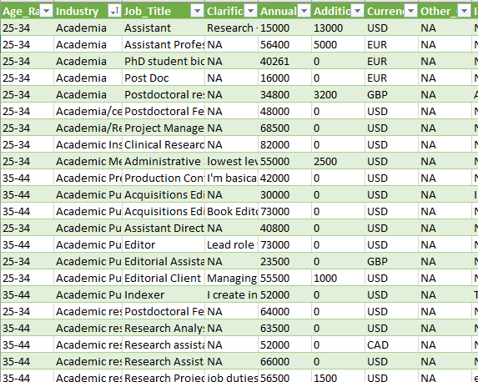
DATA CLEANING
The dataset is about salary survey for the year 2021
Handled missing values.
Inconsistent values.
Standardized data types

Slide 4
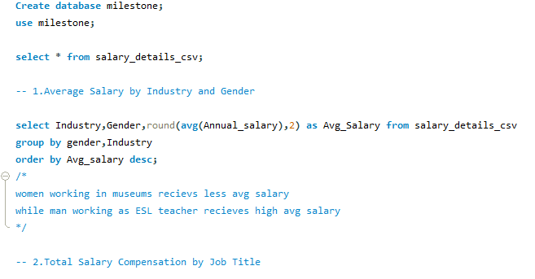
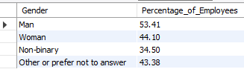
DATA QUERY
Imported cleaned into MySql.
Applied some Queries required for dashboards.
Exported into Excel files.

Slide 5
DATA MODELLING
After exporting, the tables were collected in single workbook.
Added tables to data model in Power Pivot.
Created relations(connections) across Tables.

Slide 6
DASHBOARD
Created Pivot Tables and charts.
Added Slicers.
Implemented KPI’s.

Slide 7
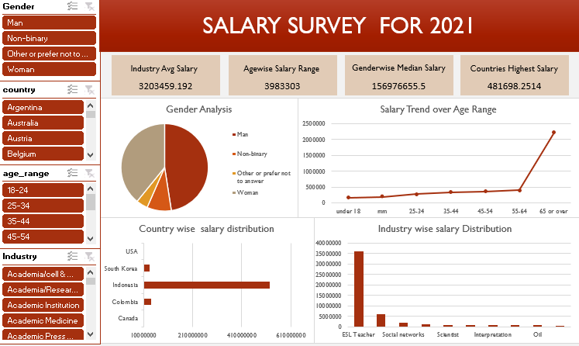

Slide 8
INSIGHTS
PhD Scholars - highest salary range.
More experience – More Salary.
“Computing or tech” - High no. of employees .

Slide 9
INSIGHTS
Experienced people – men’s Salary is High.
“Investment banking Analyst” - High salary.
Seoul tops the list and it is by ESL Teachers.

Slide 10
CONCLUSION & Recommendations
Women are high- Younger Generations
Recruit people regardless of Genders
Other Industries should Develop

Slide 11
THANK YOU

